Slide 1
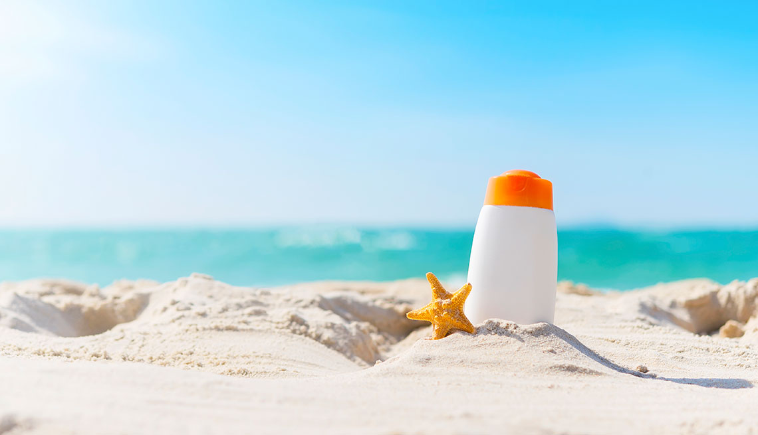
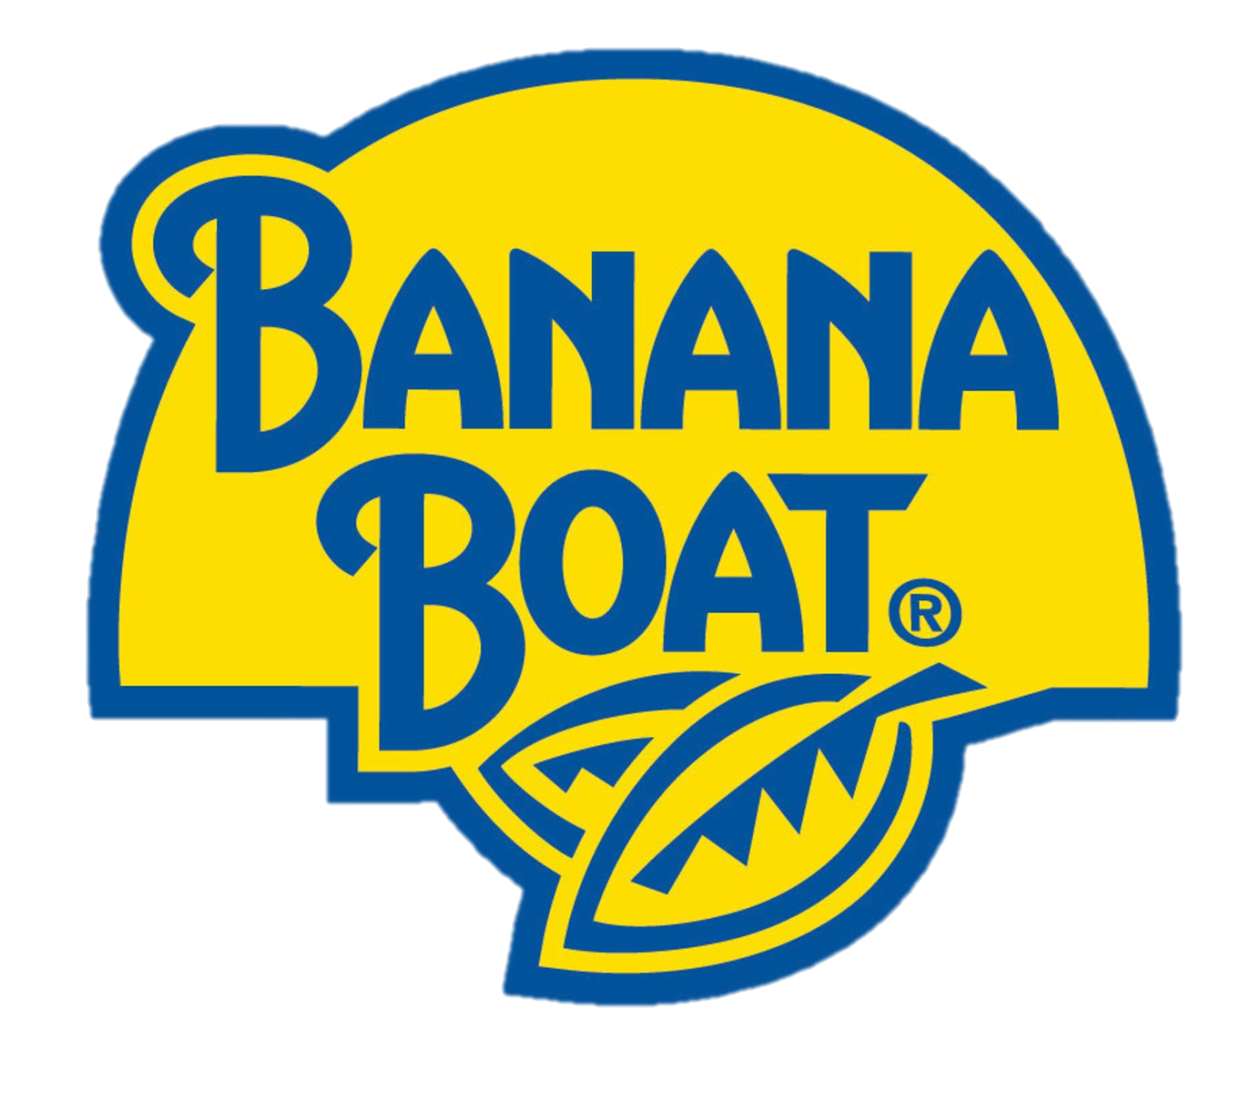
New Sunscreen Launch
Choice Based Conjoint Analysis
By Avinash, Ji, Karmel, Lin, Mingyu, Sukanya and Yadi

Slide 2
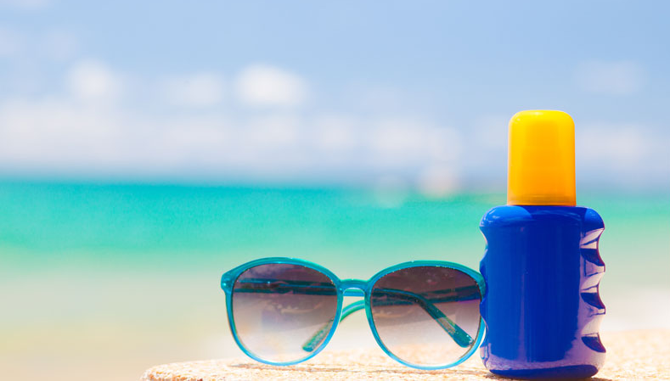
AGENDA
Introduction to Banana Boat
Problem Overview
Solution Approach
Analyses and Results
Recommendations

Slide 3
Introduction to Banana Boat

Slide 4

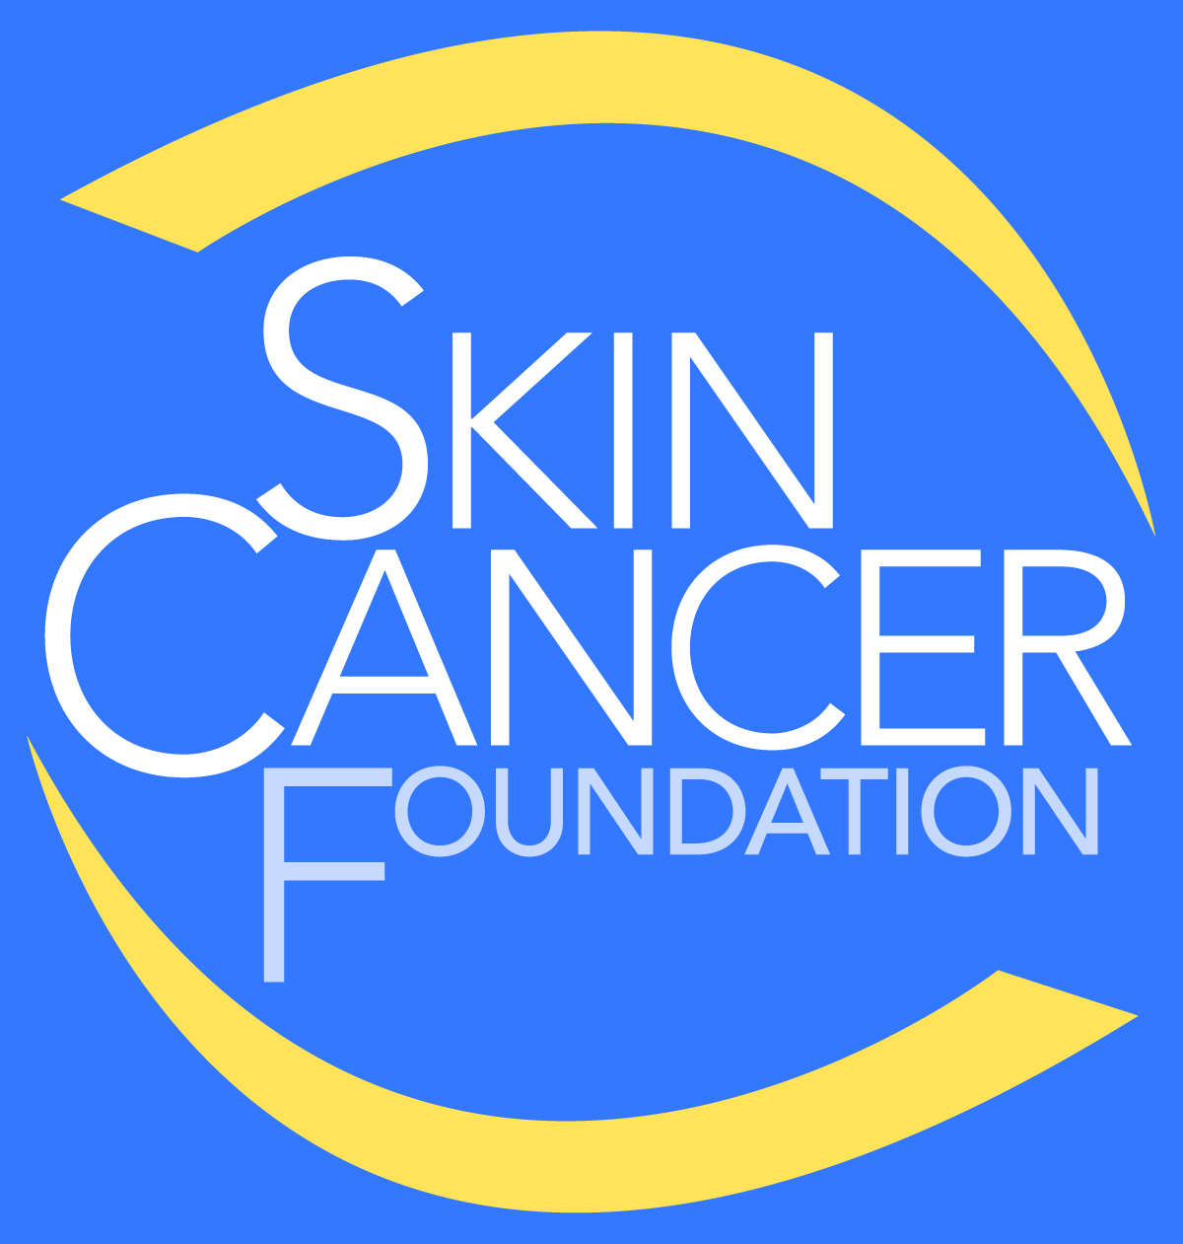
Skin Cancer Facts
01 | More people are diagnosed with skin cancer each year in the U.S. than all other cancers combined
02 | One in five Americans will develop skin cancer by the age of 70
03 | Actinic keratosis (A.K.A Solar Keratosis) is the most common precancer; it affects more than 58 million Americans
04 | The annual cost of treating skin cancers in the U.S. is estimated at $8.1 billion: about $4.8 billion for nonmelanoma skin cancers and $3.3 billion for melanoma
Ref: https://www.skincancer.org/skin-cancer-information/skin-cancer-facts

Slide 5
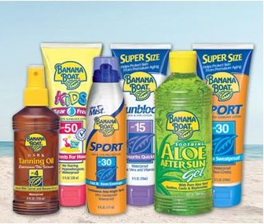
Company Context
01 | Banana Boat® products offer a wide range of options that provide today’s busy family with reliable sun protection without worry
02 | Banana Boat® has 5 Product Families: Sports Protection; General Protection; Kids & Baby; Tanning; After Sun & Sunless
03 | In the year of 2017, Banana Boat® was the 3rd leading suntan lotion brand in the United States with sales of 134 million U.S. dollars.
04 | Coppertone (26.5%), Neutrogena (21.9%), and Sun Bum (11.5%) are the main competitors of Banana Boat® (20.6%)
Ref:https://www.statista.com/statistics/301160/suntan-lotion-and-oil-brands-sales-in-the-us/
Notes:
Banana Boat® sunscreen gives you a wide range of moderate to high UVA/UVB protection to help you avoid skin cancer from the sun's harmful rays
Banana Boat® sunscreens come in several forms –such as sprays, lotions, sticks and lotion sprays, as well as in a variety of sizes to meet your lifestyle needs

Slide 6
Problem Overview

Slide 7
Introduction to the Problem
Banana Boat is launching a new product, and we are interested in knowing:
What features do people prefer? Preference Measurement
1
How can we maximize our profit? Demand and Profit Analysis
2
Who should be our target audience? Latent Segmentation
3

Slide 8
Solution Approach

Slide 9
4-Step Strategy
CHOICE-BASED CONJOINT
CUSTOMER SEGMENTATION
CUSTOMER RANKING
TARGET MARKETING
Use sawtooth to generate choice-based conjoint. Utilize mturk to collect primary data
Compare the profitability of segments & evaluate which segments product development should cater to
Develop a plan to reach the targeted consumers to gain maximum market penetration of new product
Understand what features and attributes are valued by the different customer segments
1
2
3
4

Slide 10
Solution Approach – Market Analysis

Slide 11
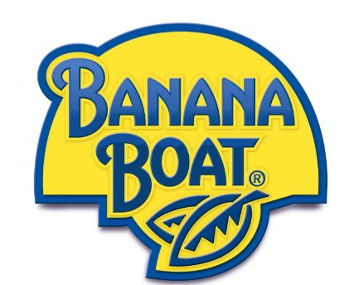
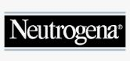

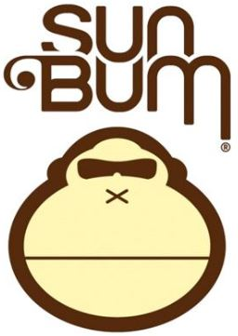
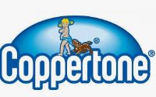
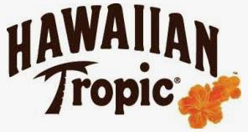
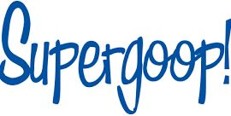
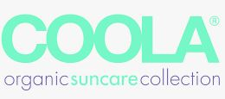
Competitive Analysis - Market
Health, natural ingredients, and social media trends have set the context for disruption of larger, mass brands like Banana Boat. Although Banana Boat is one of the dominating brands in the market in terms of share, niche brands are driving category growth. Does Banana Boat have room to expand by producing a niche sunscreen?
Mass Market
Niche Beauty
Niche Organic

Slide 12
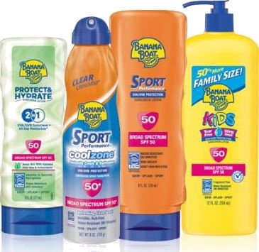
Company Analysis
Banana Boat brand spend per basket​ | $7.49​
Median share of basket spend​ | 14.7%​
Demographic​ | Caucasian & Asian women aged 25-44w/advanced degrees and kids.​
Demographic salary ​ | $80K+​
Banana Boat purchase​ | Drug stores & mass retailers​

Slide 13
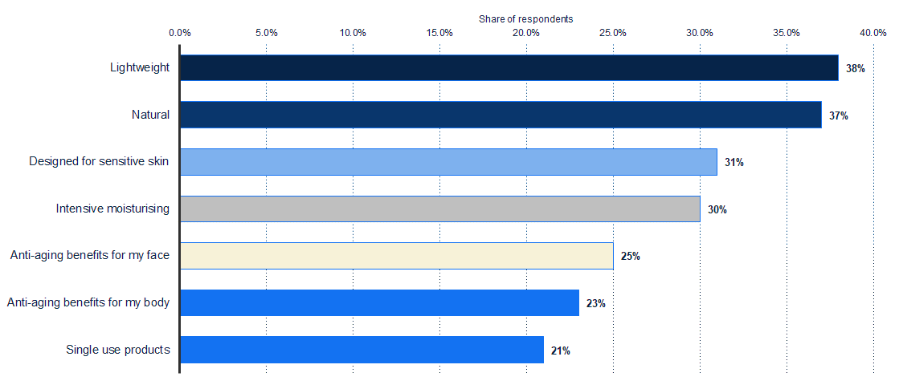
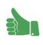
Millennial Attributes

Slide 14
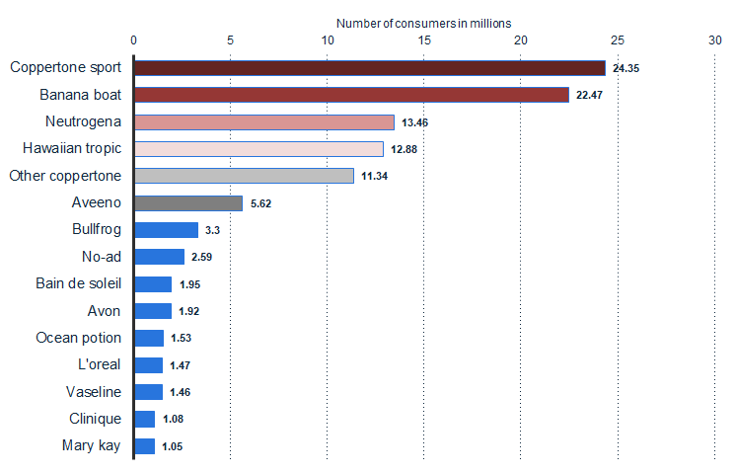
Competitive Analysis - Consumers
Although a niche market is emerging, they are not yet a threat to the Banana Boat market; however, Coppertone has already gotten in front of it by partnering with social media influencers and targeting a younger audience.

Slide 15
Comparison Chart
 | Banana Boat | Sun Bum | Neutrogena | Coppertone | La Roche
Accessibility | Drug/Grocery | Drug/Grocery/Beauty | Drug/Grocery/Beauty | Drug/Grocery | Drug/Beauty
Brand Recognition | Well-known | Niche Organic | Well-known | Well-known | Niche Beauty
Organic Ingredients | No | Yes | No | No | No
Targeted to Millennials | No | Yes | Yes | No | Yes

Slide 16
Perpetual Map

Slide 17
Solution Approach – Survey Design

Slide 18


Survey Design
Based on the market research we chose the following attributes for CBC
Ingredient Organic, Physical
1
Fragrance Scented, Unscented
2
Dispenser Cream, Spray, 2-in-1
3
Tint Tinted, Untinted
4

Slide 19
Analyses and Results

Slide 20
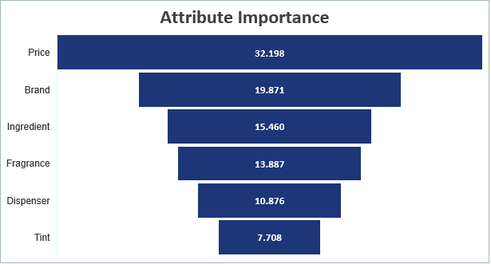
Preference Measurement

Slide 21
Preference Measurement

Slide 22
Preference Measurement
$10
Banana Boat
Organic
Unscented
Spray
Untinted

Slide 23
Demand and Profit Analysis
What other sunscreens are available in the market?
What are the market share forecasts? (What-if scenarios)
What product should ‘Banana Boat’ launch, so that profit is maximized?
1
2
3

Slide 24
Demand and Profit Analysis
What other sunscreens are available in the market?
1
Brand | Neutrogena | Sun Bum | Coppertone | Banana Boat
Price | $15 | $25 | $10 | ?
Ingredients | Physical | Organic | Organic
Fragrance | Unscented | Unscented | Unscented
Dispenser | Spray | Cream | Spray
Tint | Untinted | Tinted | Untinted

Slide 25
Demand and Profit Analysis
What are the market share forecasts? (What-if scenarios)
2
Assumptions
Market size - The Cal sun protection market size was estimated at USD 460 million in 2018
Our estimated market size – 8Mn Customers
Marginal Costs - Based on the market research we estimated marginal costs for each level of attributes
Attribute | Level | Marginal Cost
Ingredient | Physical | $ 1.50
 | Organic | $ 3.50
Tint | Tinted | $ 2.50
Fragrance | Scented | $ 2.00
Dispenser | Cream | $ 2.00
 | Spray | $ 3.00
 | 2-in-1 | $ 5.00

Slide 26
Demand and Profit Analysis
What are the market share forecasts? (What-if scenarios)
2
We used the market share simulator on Sawtooth Discover to forecast market shares for different Banana Boat product configurations, keeping the competitor products constant
Features | Level
Ingredients | Organic
Fragrance | Scented
Dispenser | Cream
Tint | Untinted
Price | Market Share | Demand | Profit
$10 | 34.60% | 2,768,000 | 11,072,000
$15 | 24.00% | 1,920,000 | 17,280,000
$25 | 11.20% | 896,000 | 17,024,000

Slide 27
Demand and Profit Analysis
What product should ‘Banana Boat’ launch, so that profit is maximized?
3
Based on the analysis so far we recommend the following product configuration -
Features | Level
Ingredients | Organic
Fragrance | Scented
Dispenser | Cream
Tint | Untinted
Price | Market Share | Demand | Profit
$10 | 34.60% | 2,768,000 | 11,072,000
$15 | 24.00% | 1,920,000 | 17,280,000
$25 | 11.20% | 896,000 | 17,024,000

Slide 28
Analyses and Results – Segmentation

Slide 29

Segmentation
Why Segmentation?
1
How many segments are optimal?
2
What are the consumer profiles?
3

Slide 30
Segmentation
Why Segmentation?
1
How many segments are optimal?
2
What are the consumer profiles?
3
Groups | AIC | CAIC | BIC | ABIC
1 | 2092.6 | 2155.2 | 2144.2 | 2109.3
2 | 1881.6 | 2012.3 | 1989.3 | 1916.3
3 | 1806.8 | 2005.8 | 1970.8 | 1859.6

Slide 31
Segmentation
Why Segmentation?
1
How many segments are optimal?
2
What are the consumer profiles?
3

Slide 32
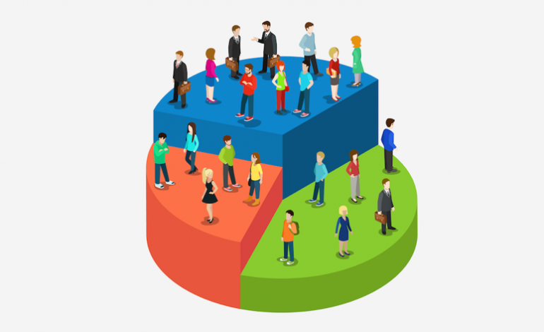
36.1%
Eco freaks :
Love organic products; like scents in their sunscreen
Not very price sensitive, prefer cream
Not too worried about sunscreen matching their skin tones; No fans of tint
41.2%
Budget Conscious:
Highly price sensitive; willing to compromise on features if offered a lower price
Look for sunscreens with average features; happy with sprays
Not loyal; budget is more important than brand value
22.7%
Brand Advocates:
Brand savvy, love ‘Banana Boat’ already
Willing to pay more money for the brand they like
Interested in trying new variety of sunscreens: organic but untinted

Slide 33
Recommendation

Slide 34

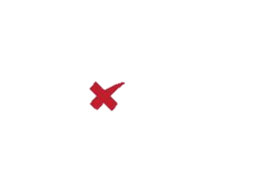
32.9%
Eco freaks :
Love organic products; like scents in their sunscreen
Not very price sensitive, prefer cream
Not too worried about sunscreen matching their skin tones; No fans of tint
Features of Final Product
44.3 %
Budget Conscious:
Highly price sensitive; willing to compromise on features if offered a lower price
Look for sunscreens with average features; happy with sprays
Not loyal; budget is more important than brand value
18.8%
Brand Advocates:
Brand savvy, love ‘Banana Boat’ already
Willing to pay more money for the brand they like
Interested in trying new variety of sunscreens: organic but untinted

Slide 35
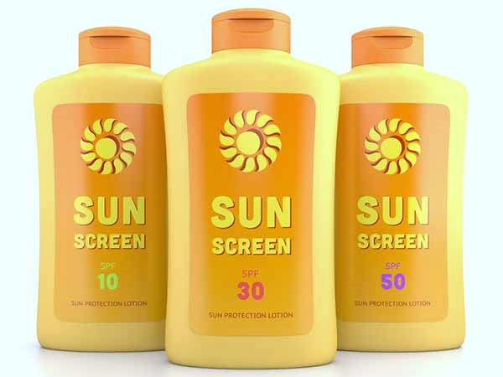
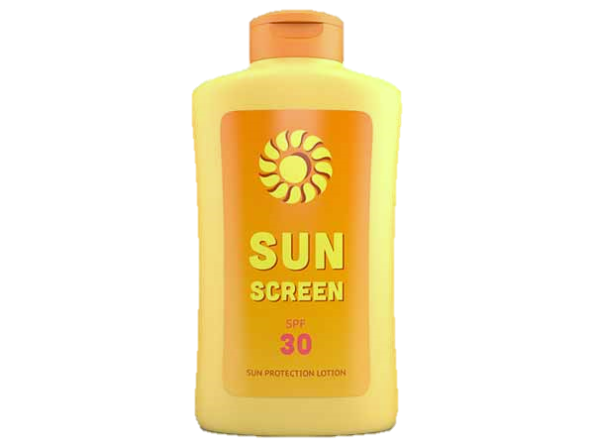
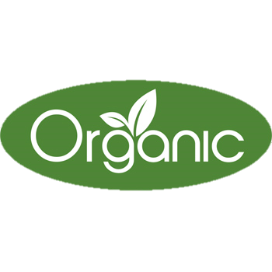

Final Product to Sell
Cream
Organic
Wide SPF Range
$15
Scented
Untinted
Untinted
Untinted
Untinted
Untinted

Slide 36
Thank You

